Slide 1
SUPPLEMENTAL SLIDES

Slide 2
Factor Loadings of Trait Orientation Items of HEMA/HEMA-R (Huta & Ryan, 2010)
 | I | II | I | II | III
Seeking to pursue excellence or a personal ideal | .8 |  | .8
Seeking to use the best in yourself | .8 |  | .8
Seeking to develop skill, learn, or gain insight into something | .8 |  | .7
Seeking to do what you believe in | .7 |  | .7
Seeking to contribute to others or the surrounding world | .8 |  | .8
Seeking pleasure |  | .8 |  | .8
Seeking fun |  | .7 |  | .8
Seeking enjoyment |  | .7 |  | .7
Seeking to take it easy |  | .8 |  |  | .8
Seeking relaxation |  | .7 |  |  | .8
Seeking to have things comfortable |  | .7 |  |  | .7
In all tables, rotation is Varimax; loadings are means across studies; loadings of .4+ shown
 | Eudaimonic Composite
Hedonic Composite | r = .3
 | Eudaimonic Composite | Comfort Composite
Pleasure Composite | r = .4 | r = .6
Comfort Composite | r = .2
Huta & Ryan (2010) N=300,321,102,114; Huta (2012) N=105; Huta et al. (2012) N=323;
Bujacz, Vittersø, Huta, & Kaczmarek (2014); Huta (analysis stage) N=1345,1324

Slide 3
Factor Loadings of State Orientation Items of HEMA/HEMA-R
 | I | II
Seeking to pursue excellence or a personal ideal | .9
Seeking to use the best in yourself | .9
Seeking to develop skill, learn, or gain insight into something | .8
Seeking to do what you believe in | .9
Seeking pleasure |  | .9
Seeking fun |  | .9
Seeking enjoyment |  | .9
Seeking to take it easy |  | .9
Seeking relaxation |  | .9
 | Eudaimonic Composite
Hedonic Composite | r= -.3
Huta & Ryan (2010) N=102,114; Myskiw, Huta, & Grouzet (unpublished honors thesis) N=34

Slide 4
Eudaimonia = “Hedonia Plus”
 | EUDAIMONIC Orientation |  | HEDONIC Orientation
EXPERIENCES: “EUDAIMONIC” Composite | .5 | > | .2
EXPERIENCES: “HEDONIC” Composite | .4 | > | .2
FUNCTIONING: “EUDAIMONIC” Composite | .6 | > | .4
FUNCTIONING: “HEDONIC” Composite | .5 | = | .5
Huta (analysis stage) N=1345, 78% female, undergraduates
Notes:
Eud pursuits just as good as hed pursuits in giving you hed wb, and sig better at giving you eud wb
This may partly explain why eud & hed are so highly correlated in the two outcome categories, experiences and functioning

Slide 5
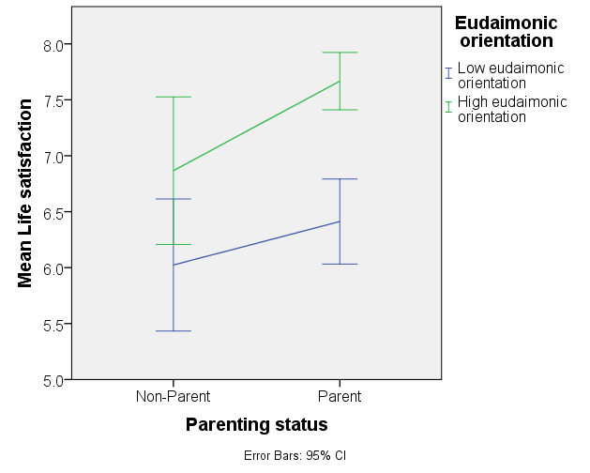
Well-being of Parents vs. Non-parents
Standardized mult. regression coefficients | Parent vs. non | Eud. Orient. | Hed. Orient. | Parent * Eud. | Parent * Hed.
Meaning experience (Huta & Ryan, 2010) | .29** | .41** | .07 | .15 | .04
Elevating experience (Huta & Ryan, 2010) | .23** | .51** | .02 | .11 | .08
Self-connectedness (Huta, 2012) | .18* | .42** | .08* | .19* | .12
Positive affect (Diener & Emmons, 1984) | .28** | .32** | .20** | .07 | .11
Negative affect (Diener & Emmons, 1984) | -.23* | -.14** | -.01 | -.15 | -.03
Carefreeness (Huta & Ryan, 2010) | .24** | .28** | .23** | .08 | .07
Life satisfaction (Bjørnskov, 2010) | .26** | .22** | .09 | .20* | .07
Vitality (Ryan & Frederick, 1997) | .16 | .42** | .12** | .20* | .04
Relatedness (ad hoc 4-item measure) | .32** | .37** | .07 | .20* | .08
Interest (Vittersø & Søholt, 2011) | .47** | .21** | .08 | .21* | .16
♦ ADULTS Gosselin, Huta, & Braaten (in prep.) N=575, 52% fem, 76% parents, strat by age 18-85

Slide 6
Trait Well-being Experiences –Undergraduates & Adolescents
Correlations | Eud. Orient. ADULT | ★ Eud. Orient. ADOL. | Hed. Orient. ADULT | ★ Hed. Orient. ADOL.
Meaning, purpose (Huta & Ryan, 2010; Lippman et al., 2014) | .4 | .3 | .2 | .1
Elevating experience (Huta & Ryan, 2010) | .4 | -- | .1 | --
Self-connectedness (Huta, 2012) | .4 | -- | .1 | --
Positive affect (Diener & Emmons, 1984; Ebesutani et al., 2012) | .3 | .4 | .4 | .3
Negative affect, depression (D. & E., 1984; Faulstich et al, 1986) | -.1 | -.1 | -.1 | .0
Carefreeness (Huta & Ryan, 2010) | .1 | -- | .3 | --
Life satisfaction (Diener et al., 1985; Huebner, 1991) | .2 | .3 | .2 | .1
Vitality (Ryan & Frederick, 1997) | .3 | -- | .2 | --
Relatedness, closeness (Gagne, 2003; Furman & Buhrmester, 1985) | .3 | .4 | .2 | .2
Huta (2016) reports multiple adult/undergraduate samples, mean correlations given here
★ ADOLESCENTS Gentzler, DeLong, … & Huta (in preparation) N=142,139, 61-70% female

Slide 7
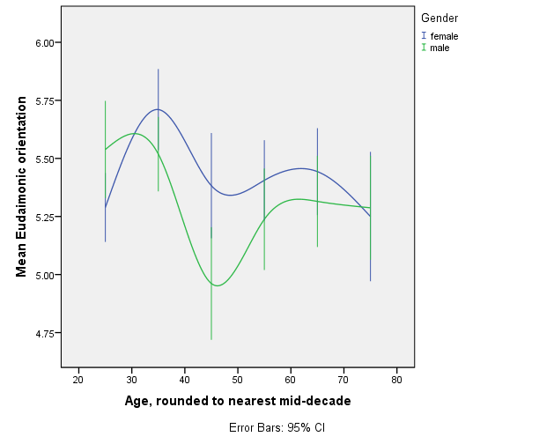
Lifespan Changes in Eudaimonic Orient.
+
♦ ADULTS Lefebvre & Huta (in prep.), N=1324, 53% female, stratified by age & ranging 18-87

Slide 8
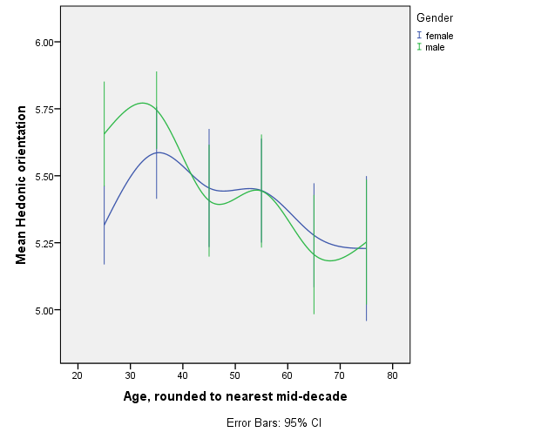
Lifespan Changes in Hedonic Orient.
♦ ADULTS Lefebvre & Huta (in prep.), N=1324, 53% female, stratified by age & ranging 18-87

